Slide 1
Pdn
The following are the goals scored during the 2015/2016 season for the Pittsburgh PENGUINS. Succinctly list 3 things you notice, find unusual, or think is unique about the data.
Player | Goals
S. Crosby | 36
C. Kunitz | 17
P. Hornqvist | 22
E. Malkin | 27
P. Kessel | 26
N. Bonino | 9
C. Sheary | 8
Player | Goals
M. Cullen | 16
K. Letang | 16
T. Daley | 6
C. Hagelin | 10
O. Matta | 6
B. Bennett | 6
B. Rust | 4

Slide 2
Central Tendency
Integrated Mathematics

Slide 3
objective
Students will calculate the central measures of tendency (mode, mean, median, and range) of a given set of data.

Slide 4
Central tendency
Central Tendency is the tendency of samples of a given measurement to cluster around some central value.
It is a measure that identifies a single score as a representative for an entire distribution or data set.
Three common measures of central tendency are mean, median, and mode.

Slide 5
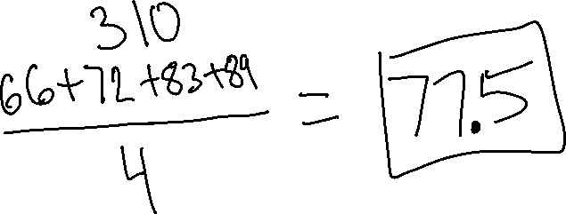
MEAN
Mean is the average value of all data in a set.
Add up the numbers then divide by the number of values in the set to find the mean.
Example: Find the mean of the following:
{66, 72, 83, 89}

Slide 6
Median
The median is the value that has exactly half the data above it and half below it.
Order the numbers from smallest to largest.
  If there is an odd number of data in the set, then the middle number is the median.
  If there is an even number of data in the set, then the median is the mean of the two middle numbers.

Slide 7
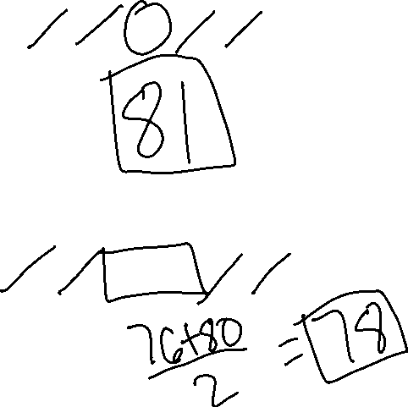
median
Example 1: Find the median of the following:
{65, 72, 81, 83, 89}
Example 2: Find the median of the following:
{65, 72, 76, 80, 83, 89}

Slide 8
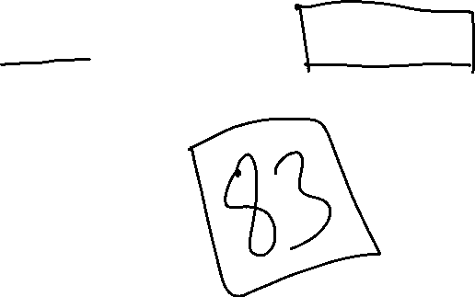
mode
The mode is the number that appears most often in the set.
Example: Find the mode of the following:
{65, 65, 71, 72, 81, 83, 83, 83, 89}

Slide 9
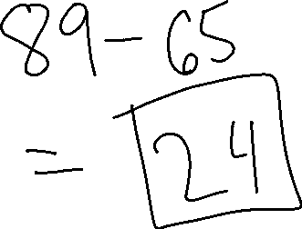
RANGE
The range is the difference between the smallest and largest numbers in the set.
Example: Find the range of the following:
{65, 65, 71, 72, 81, 83, 83, 83, 89}

Slide 10
objective
Students will compare the central measures of tendency of a given set of data.

Slide 11
quartiles
Data can be separated into quartiles, each of which contains 25% of the total data.
The first quartile is the median of the lower half of the data set.
The second quartile is the median of the data set.
The third quartile is the median of the upper half of the data set.

Slide 12
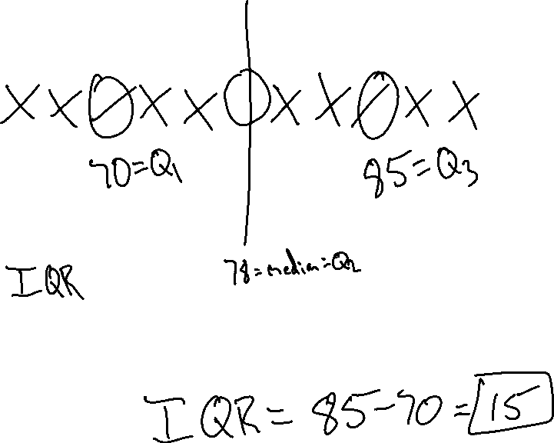
quartiles
Example:
{60, 65, 70, 75, 76, 78, 80, 83, 85, 87, 90}
The interquartile range contains 50% of the data and is calculated by subtracting the 1st quartile from the 3rd quartile.

Slide 13
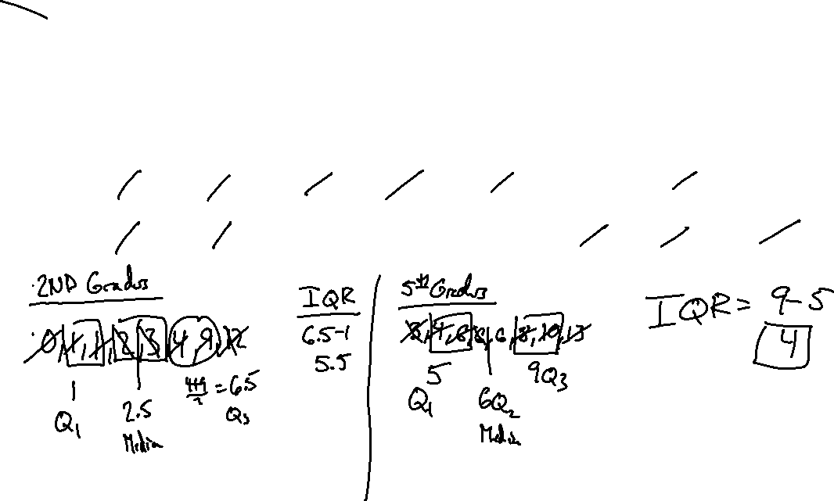
Comparing measures of central tendency
Eight second graders and eight fifth graders at Cherry Hills Elementary School were asked how many first cousins they have.
Number of First Cousins
Second Grade | 2 | 4 | 1 | 0 | 1 | 9 | 3 | 12
Fifth Grade | 6 | 3 | 10 | 13 | 8 | 4 | 6 | 6

Slide 14
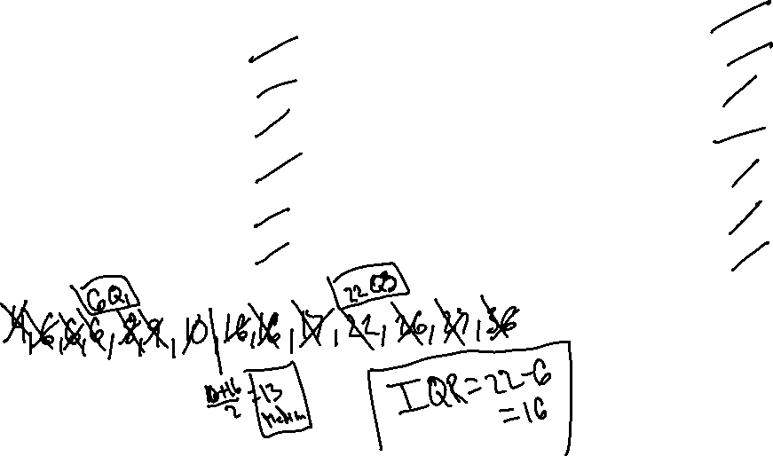
Comparing data with measures of central tendency
Player | Goals
S. Crosby | 36
C. Kunitz | 17
P. Hornqvist | 22
E. Malkin | 27
P. Kessel | 26
N. Bonino | 9
C. Sheary | 8
Player | Goals
M. Cullen | 16
K. Letang | 16
T. Daley | 6
C. Hagelin | 10
O. Matta | 6
B. Bennett | 6
B. Rust | 4

